Slide 1
Breast Cancer prediction

Slide 2
By:
Gnana Prasuna Gorantla- (700745497)
Deepthi- (700657975)
Divakar- (700741929)
Nikhil- (700742318)

Slide 3
Contributions
Individual Contributions | Activities
Gnana Prasuna | Data collection and preparation, Exploratory data analysis
Deepthi Vemula | LDA & QDA Models, documenting results
Divakar | Baseline Model & Coding
Nikhil | Document and compare the results

Slide 4
Motivation
Cancer is a serious health problem that is spreading around the world and is one of the main causes of death.
According to recent statistics, breast cancer is the second most common disease that causes death in women
Early identification of breast cancer through screening methods can improve survival rates
There are multiple screening methods: Mammogram, MRI and FNA

Slide 5
Objectives
The main objective of this prediction is
Collection of the data from FNA process
Utilize multiple reduction techniques to lower the dimensions of the data
Apply machine learning techniques to classify the benign & malignant tumor in the breast and compare the results with the traditional procedures.

Slide 6
Related work
Exploratory Data Analysis
KNN(K- Nearest Neighbour)
Decision tree
Naive Bayes algorithms
SVM (Support Vector Machine)
Random Forest classifiers
AdaBoost and Gradient Boosting algorithms

Slide 7
Problem Statement
There are different classification models that classify or predict breast cancer using clinical data, but selecting the best model that suits the problem is a challenge
Usually, diagnostics data come in high dimensions, which is a challenging task to process

Slide 8
Proposed solutions
The data is collected from UCI machine learning repository
The data is passed through the dimensionality reduction methods to reduce the data to lower dimensions
Machine learning techniques are applied on the reduced data to classify the data
LDA in conjunction with SVM classifier
QDA in conjunction with SVM classifier
A baseline model of SVM is implemented on the original dataset to compare the performance with LDA and QDA methods

Slide 9
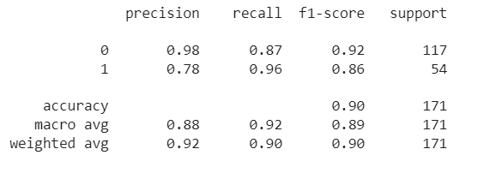
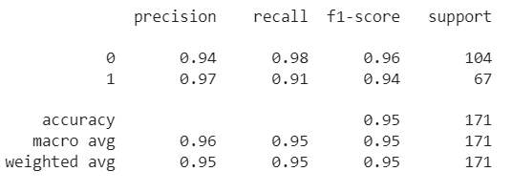
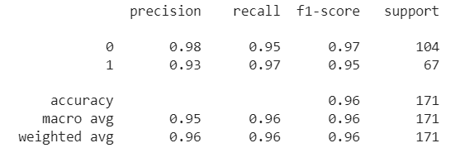
Results
SVM baseline model
The baseline model achieved 90% accuracy on the test data, with the highest F1 score of benign data(0)
The LDA and QDA models performed well than the baseline model and achieved 95% and 96% accuracy on the test data. The F1 score has also increased
LDA with SVM model
QDA with SVM model

Slide 10
References
[1]. R. K. Barwal and N. Raheja, "A Classification System for Breast Cancer Prediction using SVOF-KNN method," 2022 International Conference on Augmented Intelligence and Sustainable Systems (ICAISS), Trichy, India, 2022
[2]. S. Kaya and M. Yağanoğlu, "An Example of Performance Comparison of Supervised Machine Learning Algorithms Before and After PCA and LDA Application: Breast Cancer Detection," 2020 Innovations in Intelligent Systems and Applications Conference (ASYU), Istanbul, Turkey, 2020
[3]. J. Aditya, "Optimized Ensemble Prediction Model for Breast Cancer," 2021 International Conference on Intelligent Technology, System and Service for Internet of Everything (ITSS-IoE), Sana'a, Yemen, 2021
[4]. A. Rovshenov and S. Peker, "Performance Comparison of Different Machine Learning Techniques for Early Prediction of Breast Cancer using Wisconsin Breast Cancer Dataset," 2022

